Slide 1
El Nino and la nina

Slide 2
El Nino

Slide 3
What is El Nino?

Slide 4
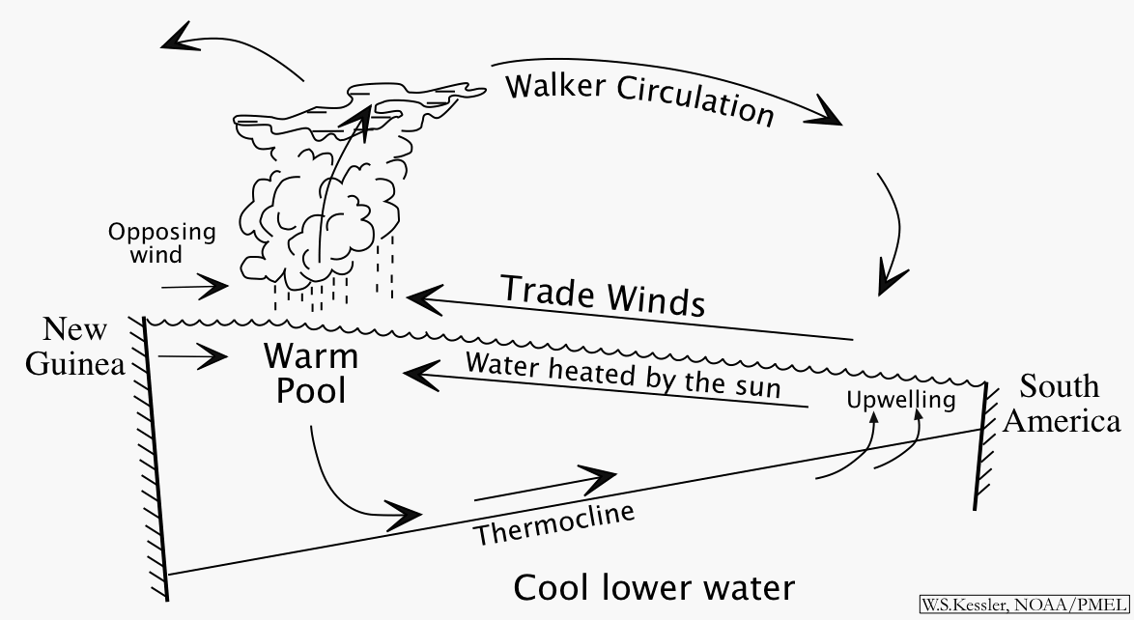
Picture explanation of el nino

Slide 5
El nino vs la nina

Slide 6
Now what?
1st you need to go to my webpage and click on the el nino questions, and answer them either on your computer and email them to me kayalaj@bath.k12.va.us or you may write them and turn them in.
2nd you need to go back to my webpage and click on can we blame el nino, you will need this to answer the questions el nino/la nina questions also found on my webpage. You may email it, or write your answers and turn them in. If you do not finish, this assignment becomes homework! This powerpoint is on my webpage so make sure you save a copy so you know what to do!

